Slide 1
int217 (Excel dashboard on IPL dataset)
INTRODUCTION TO DATA MANAGEMENT

Slide 2
Name : Shruti Tandon Registration No. : 11902188 Section :K19MB
Course : Integrated B.Tech. (CSE) - MBA

Slide 3



What is excel?
Microsoft excel is a computer application program written by Microsoft. It mainly comprises tabs, groups of commands, and worksheets. It stores the data in tabular form and allows the users to perform manipulation operations on them. Microsoft excel is an office use application designed by Microsoft. It comes with office suite with several other Microsoft applications, such as word, PowerPoint, access, outlook, and One note, etc. It is supported in windows as well as mac operating system too.
It is one of the most suitable spreadsheet programs that help us to store and represent the data in tabular form, manage and manipulate data, create optically logical charts, and more. Excel provides us the worksheet to create a new document in it. You can save the excel file with .xls extension.

Slide 4
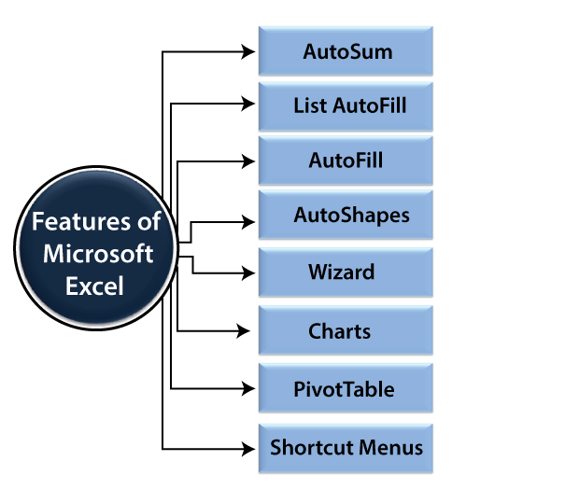
Features of MS Excel

Slide 5
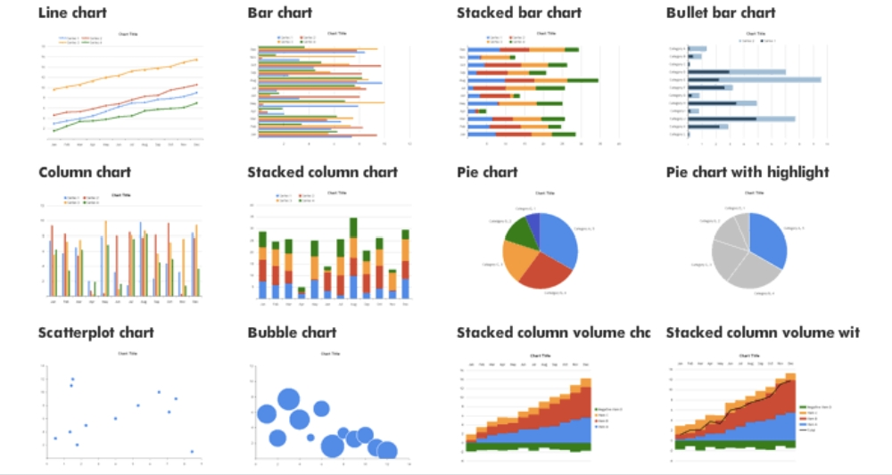
Types of CHARTS IN MS EXCEL

Slide 6

Introduction about the Dataset
My dataset is on IPL statistics from 2008-2019. The Indian premier league (IPL) is a professional twenty20 cricket league, contested by eight teams based out of eight Indian cities. The league was founded by the board of control for cricket in India (BCCI) in 2007. It is usually held between march and may of every year and has an exclusive window in the ICC future tours program. The IPL is the most-attended cricket league in the world and in 2014 was ranked sixth by average attendance among all sports leagues.

Slide 7
SOURCE OF DATASET
IPL Dataset (2008-2019)
Kaggle: https://www.kaggle.com/ramjidoolla/ipl-data-set

Slide 8
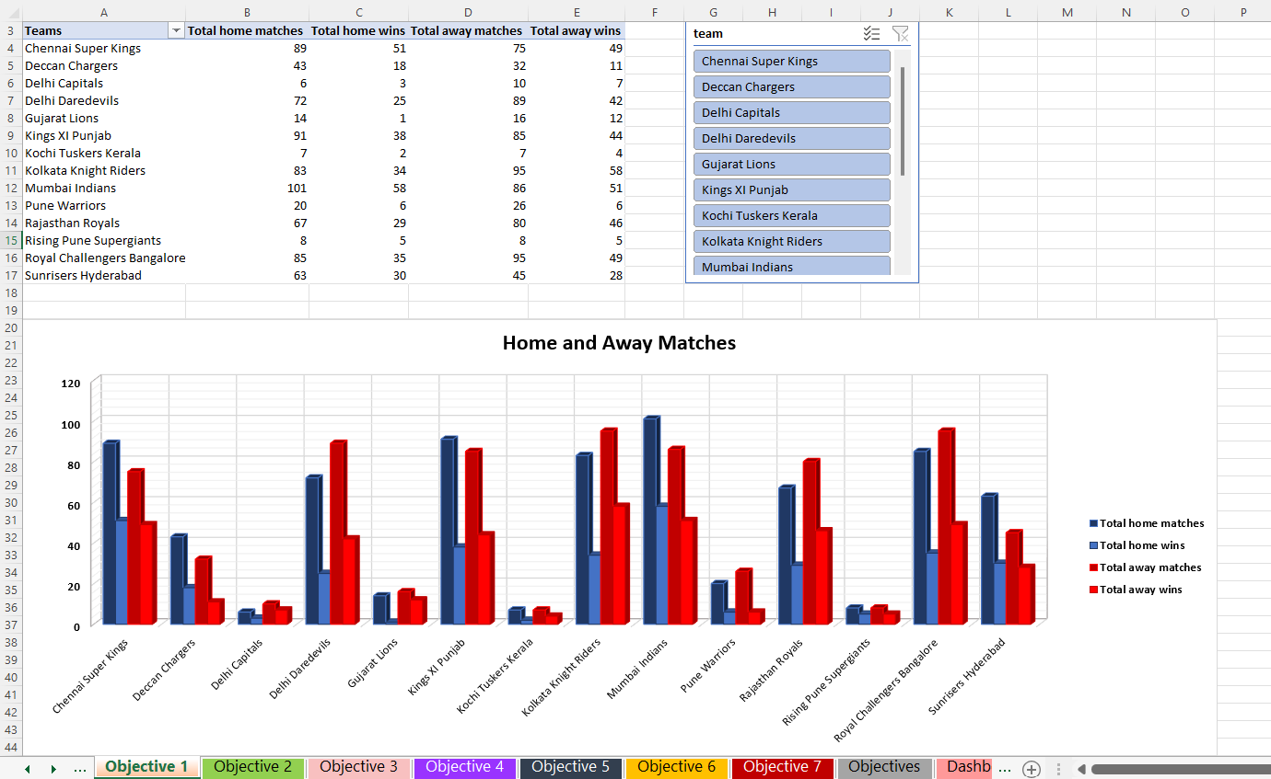
Objective-1
Analyze the ratio of home win and away win.
This objective is about the ratio of home win and away win for each team in IPL. In this I have calculated the total number of home matches played by a respective team and the number of times that team won in its home ground. I have also calculated the total number of away matches played by a team and the number of wins in away matches. I have displayed the data using 3-D clustered column chart type and have also used a slicer to display the results of a selected team.

Slide 9
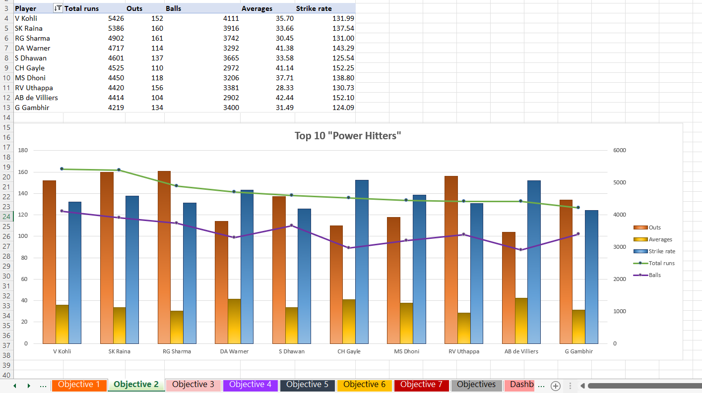
Objective-2
Top 10 "Powe Hitter" batsman of the IPL with their strike rate and average.
This objective filter outs the top 10 “Power Hitter” batsman of the IPL by analysing the total number of runs made throughout, the number of balls played, number of times a player got dismissed and the average and strike rate of a player. For displaying the results, I have used Combo chart having Clustered column and marked line graph.

Slide 10
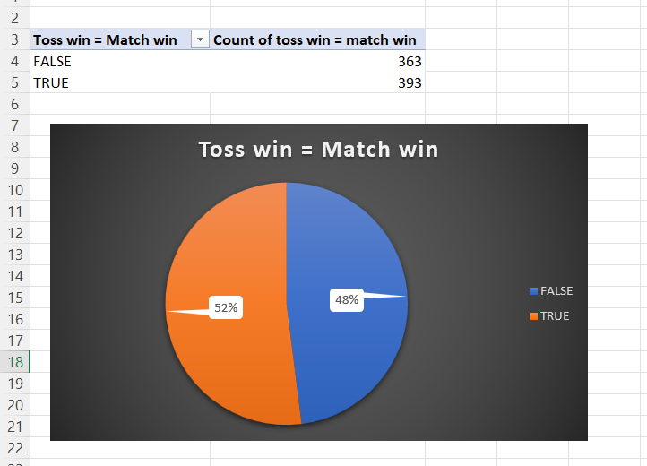
Objective-3
Analyse the dependency of Toss win on Match win.
This objective analyses the dependency of Toss win on Match win. How much the winning of toss and then deciding whether to bowl or bat first influences the chances of match winning for a team is depicted using a pie chart. It shows that 52% matches were won by the team who won the toss. I have displayed the results using a Pie chart.

Slide 11
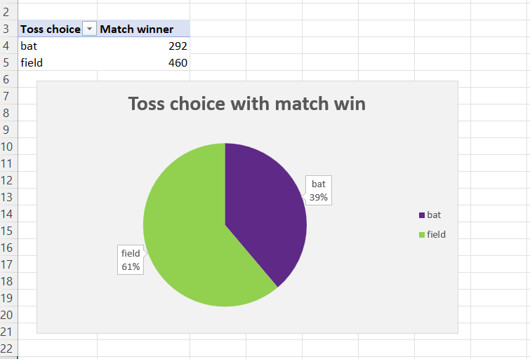
Objective-4
Analyse the respected winning team by making toss decision as bat or field.
This objective analyses that after winning a toss how many times a team won the match by making the decision of fielding first or to bat first. 61% times a team won by deciding to field or bowl first. I have displayed the results using a Pie chart.

Slide 12
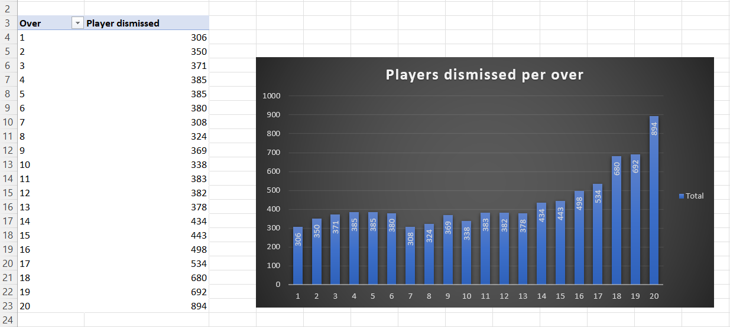
Objective-5
Total number of wickets in each over in IPL.
This objective analyses the number of wickets in each over in IPL. It counts the number of players dismissed per over. It tells us that in the first over the number of players that get dismissed is least as compared to the maximum number of wickets in the last i.e., 20th over. I have used Clustered column chart type to display the result from first to last over.

Slide 13
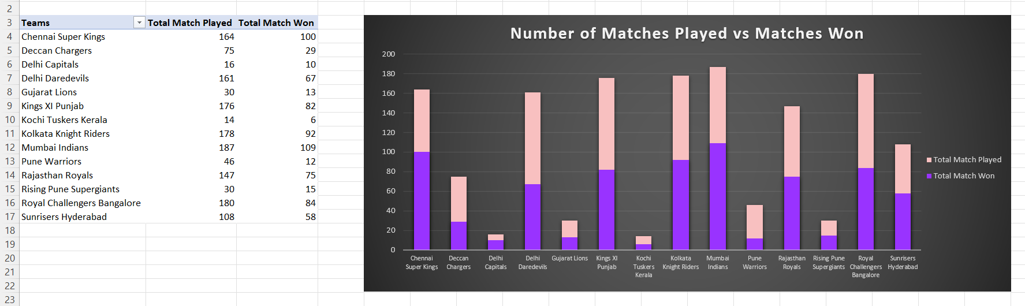
Objective-6
Total matches won and played by each team.
This objective counts the total number of matches played and won by each team in IPL from 2008-2019. I have taken the data from teamwise_home_and_away table. For displaying the result, I have used Clustered column which shows the total number of matches played by a team and the number of matches won by that team.

Slide 14
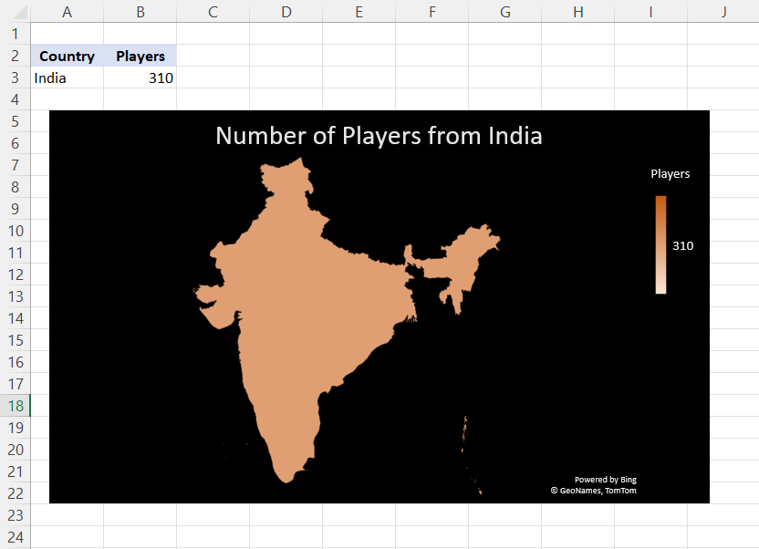
Objective-7
Total no. of players from India.
In this objective I have analysed the total number of players which are from India. For this I have used the chart type Filled Map. There are a total of 310 Indian players in different IPL teams.

Slide 15
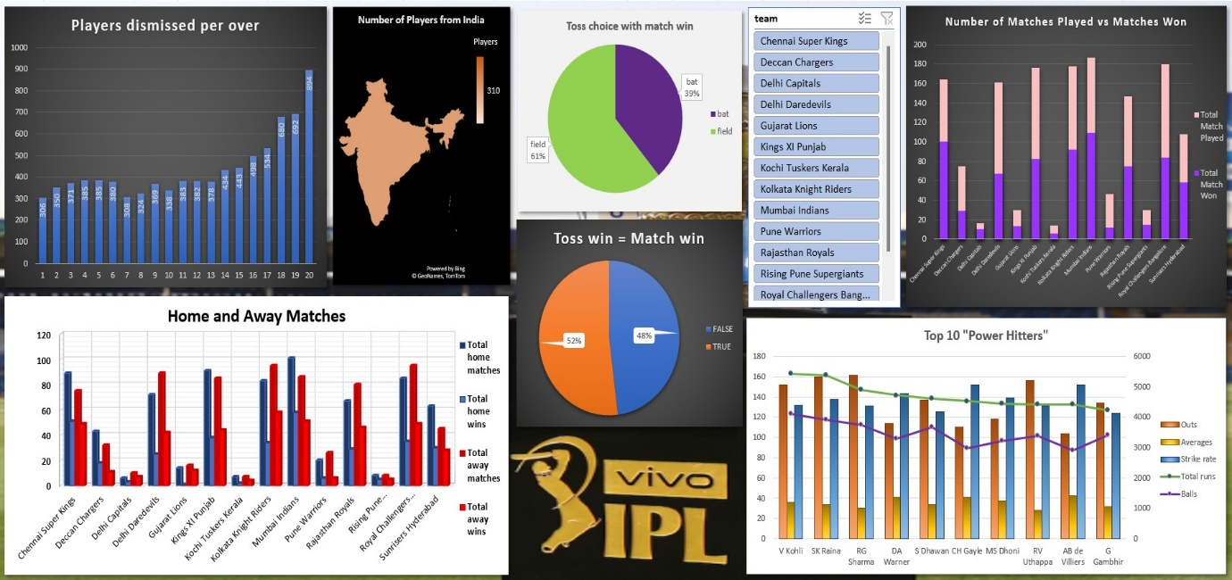
DASHBOARD

Slide 16
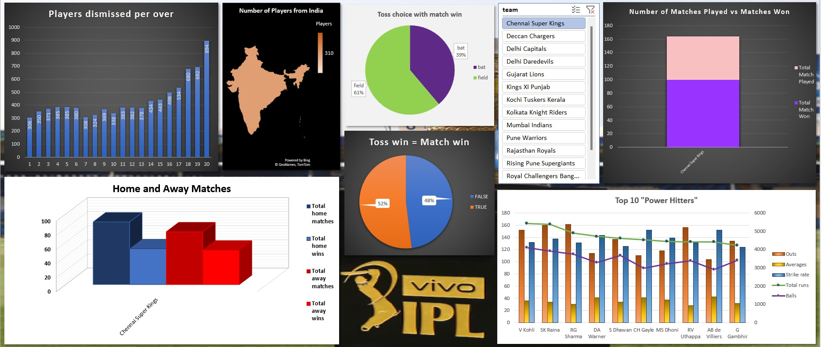
After clicking the slicer and selecting a team say, “Chennai Super Kings”. Data of “Chennai Super Kings” is shown for “home and away matches 3-D column chart” and “number of matches played vs matches won stacked column chart”.

Slide 17
Conclusion
Overall, this project was a useful experience. I have gained some useful knowledge about data analysis and MS Excel. I was able to conclude some insights from IPL dataset . I analysed information from the dataset like the ratio of home win and away win, Top 10 "Powe Hitter" batsman of the IPL with their strike rate and average, dependency of toss win on match win, respected winning team by making toss decision as bat or field, Over-wise wickets, total matches played and won by each team and number of players from India. I also learned scope of using MS Excel its formulas and features and practically applying them to analyse information from a dataset. I worked with Pivot table to analyse data from worksheets. I explored different types of charts and maps, and design them to give a presentable representation of analysed information. I used ETL process make proper use of the dataset by cleaning and organising it. It helped to develop data management and analysis skills.
I represented all the analysed insights on a dashboard and used slicers to filter the data get personalised extracted information from the dataset. The dashboard offered a common, user friendly and interactive place for a good user interface.
In conclusion this was helpful, and I got to practice a lot of the data management and analysis techniques and skills and got a good hands-on experience on the MS Excel software, explored workbooks, worksheets, formulas, features like, Pivot tables, charts, etc. In this data driven world, I am well-verse basics of data analysis and MS Excel software which will help in the Data Science minor. It strengthened my professional ability to work with datasets.

Slide 18
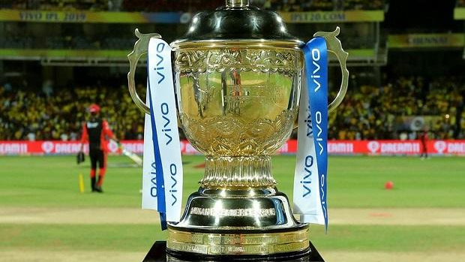

Thank You
This Photo by Unknown Author is licensed under CC BY

